Slide 1
Module 9:
Cursors In MS SQL

Slide 2
Objectives
At the end of the session, you will learn:
Overview of cursors
Steps to create and use a cursor
Advantages and Disadvantages of cursor

Slide 3

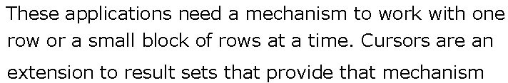
Overview of Cursors

Slide 4

Features of Cursors

Slide 5
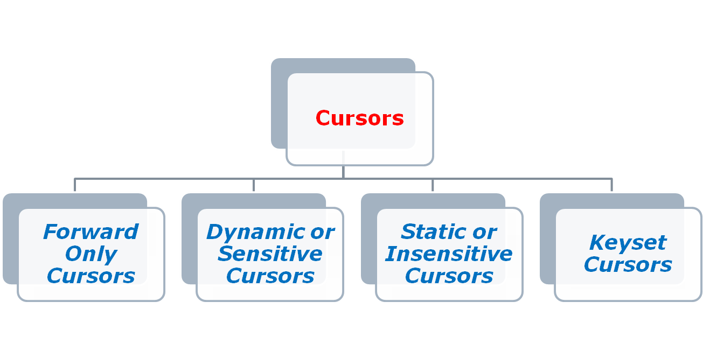
Types of Cursors

Slide 6


Steps to create and use Cursors

Slide 7

Forward Only Cursors

Slide 8

Dynamic Cursors

Slide 9


Static Cursors

Slide 10


Keyset Cursors

Slide 11
Disadvantages of Cursors

Slide 12
Thank You…!

